Slide 1
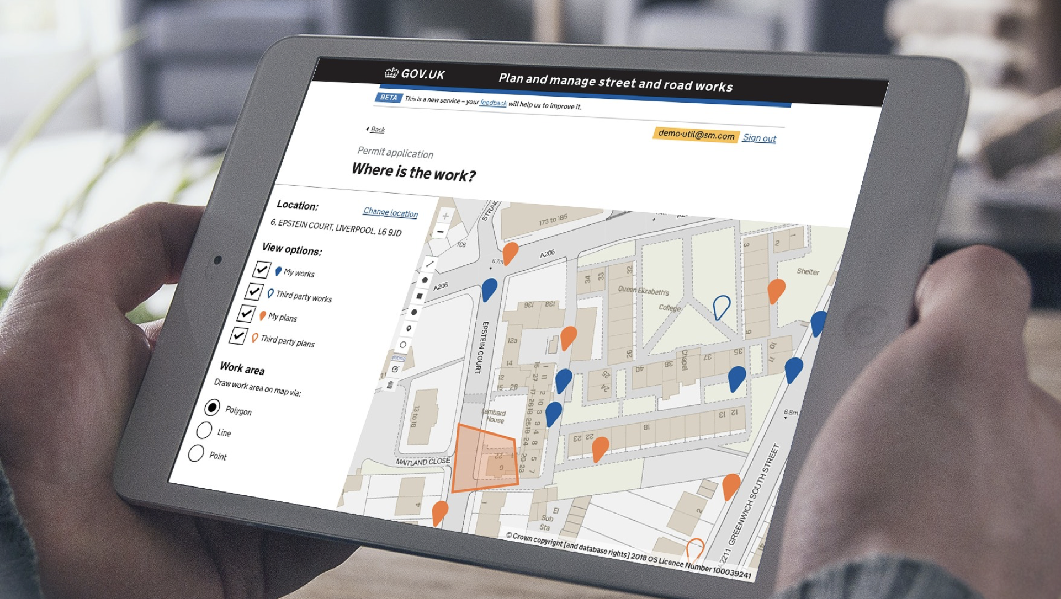

Street Manager Communications approach
@ Crown copyright

Slide 2
Contents
Introduction
Overview
Best practice and guidance
Communications delivery options
Communications checklist
Communications roadmap

Slide 3
Introduction
Purpose of this document
This document outlines the approach, best practice and some recommended techniques to deliver communications to support the transition to Street Manager.
The document provides some guidance to assess the comms requirements for your organisation by looking at the different stakeholders, comms triggers and approaches.
The document is intended for guidance only and you are free to use any method, model or approach that suits you and your organisation’s needs.
You may also want to consider using the Engagement tracker for detailed needs assessment and tracking of activities and progress down to individual stakeholders. You can find the tracking tool here : Link to document
Disclaimer
The information provided in this pack is purely a recommendation and it is up to you to edit the content in line with your organisation’s transition plan. What the right approach for your organisation is will be dependent on a number of factors such as how and when you plan to move to Street Manager environment, and what are the specific needs and preferences of your stakeholders.

Slide 4



Communication overview
Approach
Communication should be delivered based on the following principles:
Open, clear, honest and transparent communications,
Iterative, continuous and timely ensuring everyone is kept informed
Aligned to overall change management approach
Varied Comms
Triggers
Methods & channels
Your comms approach will have to take into consideration the various levels and types of people that need to be informed. The comms sent to the finance director, for example, will be different to those for an end user. For those organisations who completed personas in the 1st playbook, it is good to align these to your comms approach.
There are a number of triggers that will necessitate communications to your wider organisation and external stakeholders around Street Manager This will include, but is not limited to, legislative changes, training announcements and the decision to transition. The communication plan should be built around these triggers.
There are various means through which a message can be communicated to individuals, groups and your organisation as a whole. In this pack, you will find a number of different options for comms channels. You should consider the range, impact and costs of such comms as well as stakeholder preferences. This can be used in conjunction with the engagement tracker.

Slide 5
Best practice and guidance
Things to consider
Who needs to be communicated with?
Comms is not limited to those directly using Street Manager. You should also consider communicating with those not using the system as well as all contractors, IT vendors, regulatory bodies, and all other internal and external stakeholders playing a role in your transition to Street Manager.
Impact vs. Preference: It is important to consider preferences when determining comms channels. While face-to-face might take most effort, if this is the preference of the stakeholder, it might be the most effective option.
How to complete the Roadmap
The roadmap provided is simply an example of some of the comms that you may wish to pass on to your stakeholders, the channels you may wish to use and when you may want to send out information.
You should start by considering who you need to engage with and what you need to tell them.
You can then break these down into when and how these messages need to be communicated out.
Disclaimer
The information provided in this pack is purely a recommendation and it is up to you to edit the content in line with your organisation and transition plan. Comms will have to be aligned to the overall change strategy, taking into consideration factors including if you are using an API or if you are transitioning with a big bang approach.

Slide 6







Methods and channels options
Channel |  | Triggers | Reach | Impact | Cost, effort | Considerations
 | 1-2-1 meetings | Transitioning; Business case completion; agree timelines with contractors/regional | Narrow | High | Medium | Depends on number of individuals required to speak to
 | Group web /phone calls | Transitioning; Training; Queries; Agree timelines with external bodies | Narrow | High | Medium | Depends on numbers
 | 1-2-1 emails | Queries; Individual training requirements, Comms with DfT to confirm plans | Narrow | High | Low cost, medium effort
 | Mass emails | Updates on transition dates; Announcements | Wide | Low to medium | Low | Might not reach target audience
 | Drop-ins | Training; Queries General updates | Medium to wide | Medium to high | High
 | Supporter driven comms | Lead up to transition; Regular intervals | Narrow to medium | High | High | Requires engagement with supporters
 | Videos / success stories / testimonials | Transitioning; Regular intervals | Wide | Medium | Medium | Dependent on volunteers
 | Company update | Regular intervals; Announcements; Legislation Update | Wide | High | Low | Depends if forum exists already
6

Slide 7



Comms Checklist
Now
3 months before
1 month before
1 week before
Speak to all your contractors about SM
Discuss with other LHAs and Utilities in the region about transition plans
Begin communicating with your organisation about the new system
Confirm to end users and contractors when you are going to transition (company update)
Confirm to other organisations when you will transition
Use supporters to gain momentum
Send out specific comms to early testers
Run drop-in sessions
1-2-1 sessions for main users
Countdown to transition counter
Run drop in sessions
Company update engagement
All points on this checklists are recommendations only that you can choose to do at any point in the lead up to transition

Slide 8
High-level communications plan
Scope update
Complete
In progress
Not started
Comms Supplier | Now | Before transition has commenced | During transition | Just before completion of transition
Dft Project |  | Survey
Organisation
Training announcements
Training announcements
Web /F2F conferences
Web /F2F conferences
Survey
Survey
HAUC events
Engage with contractors
Transition Date Announcement
Training announcements
Training announcements
Company Update
Engage with region
Company Update
Drop In Sessions
Share success stories
This plan covers both comms coming from you to your organisation and other stakeholders as well as the from the DfT to all organisations.

